Slide 1




LOGO
Handle
@Handle

Slide 2

LOGO
Handle
@Handle

Slide 3
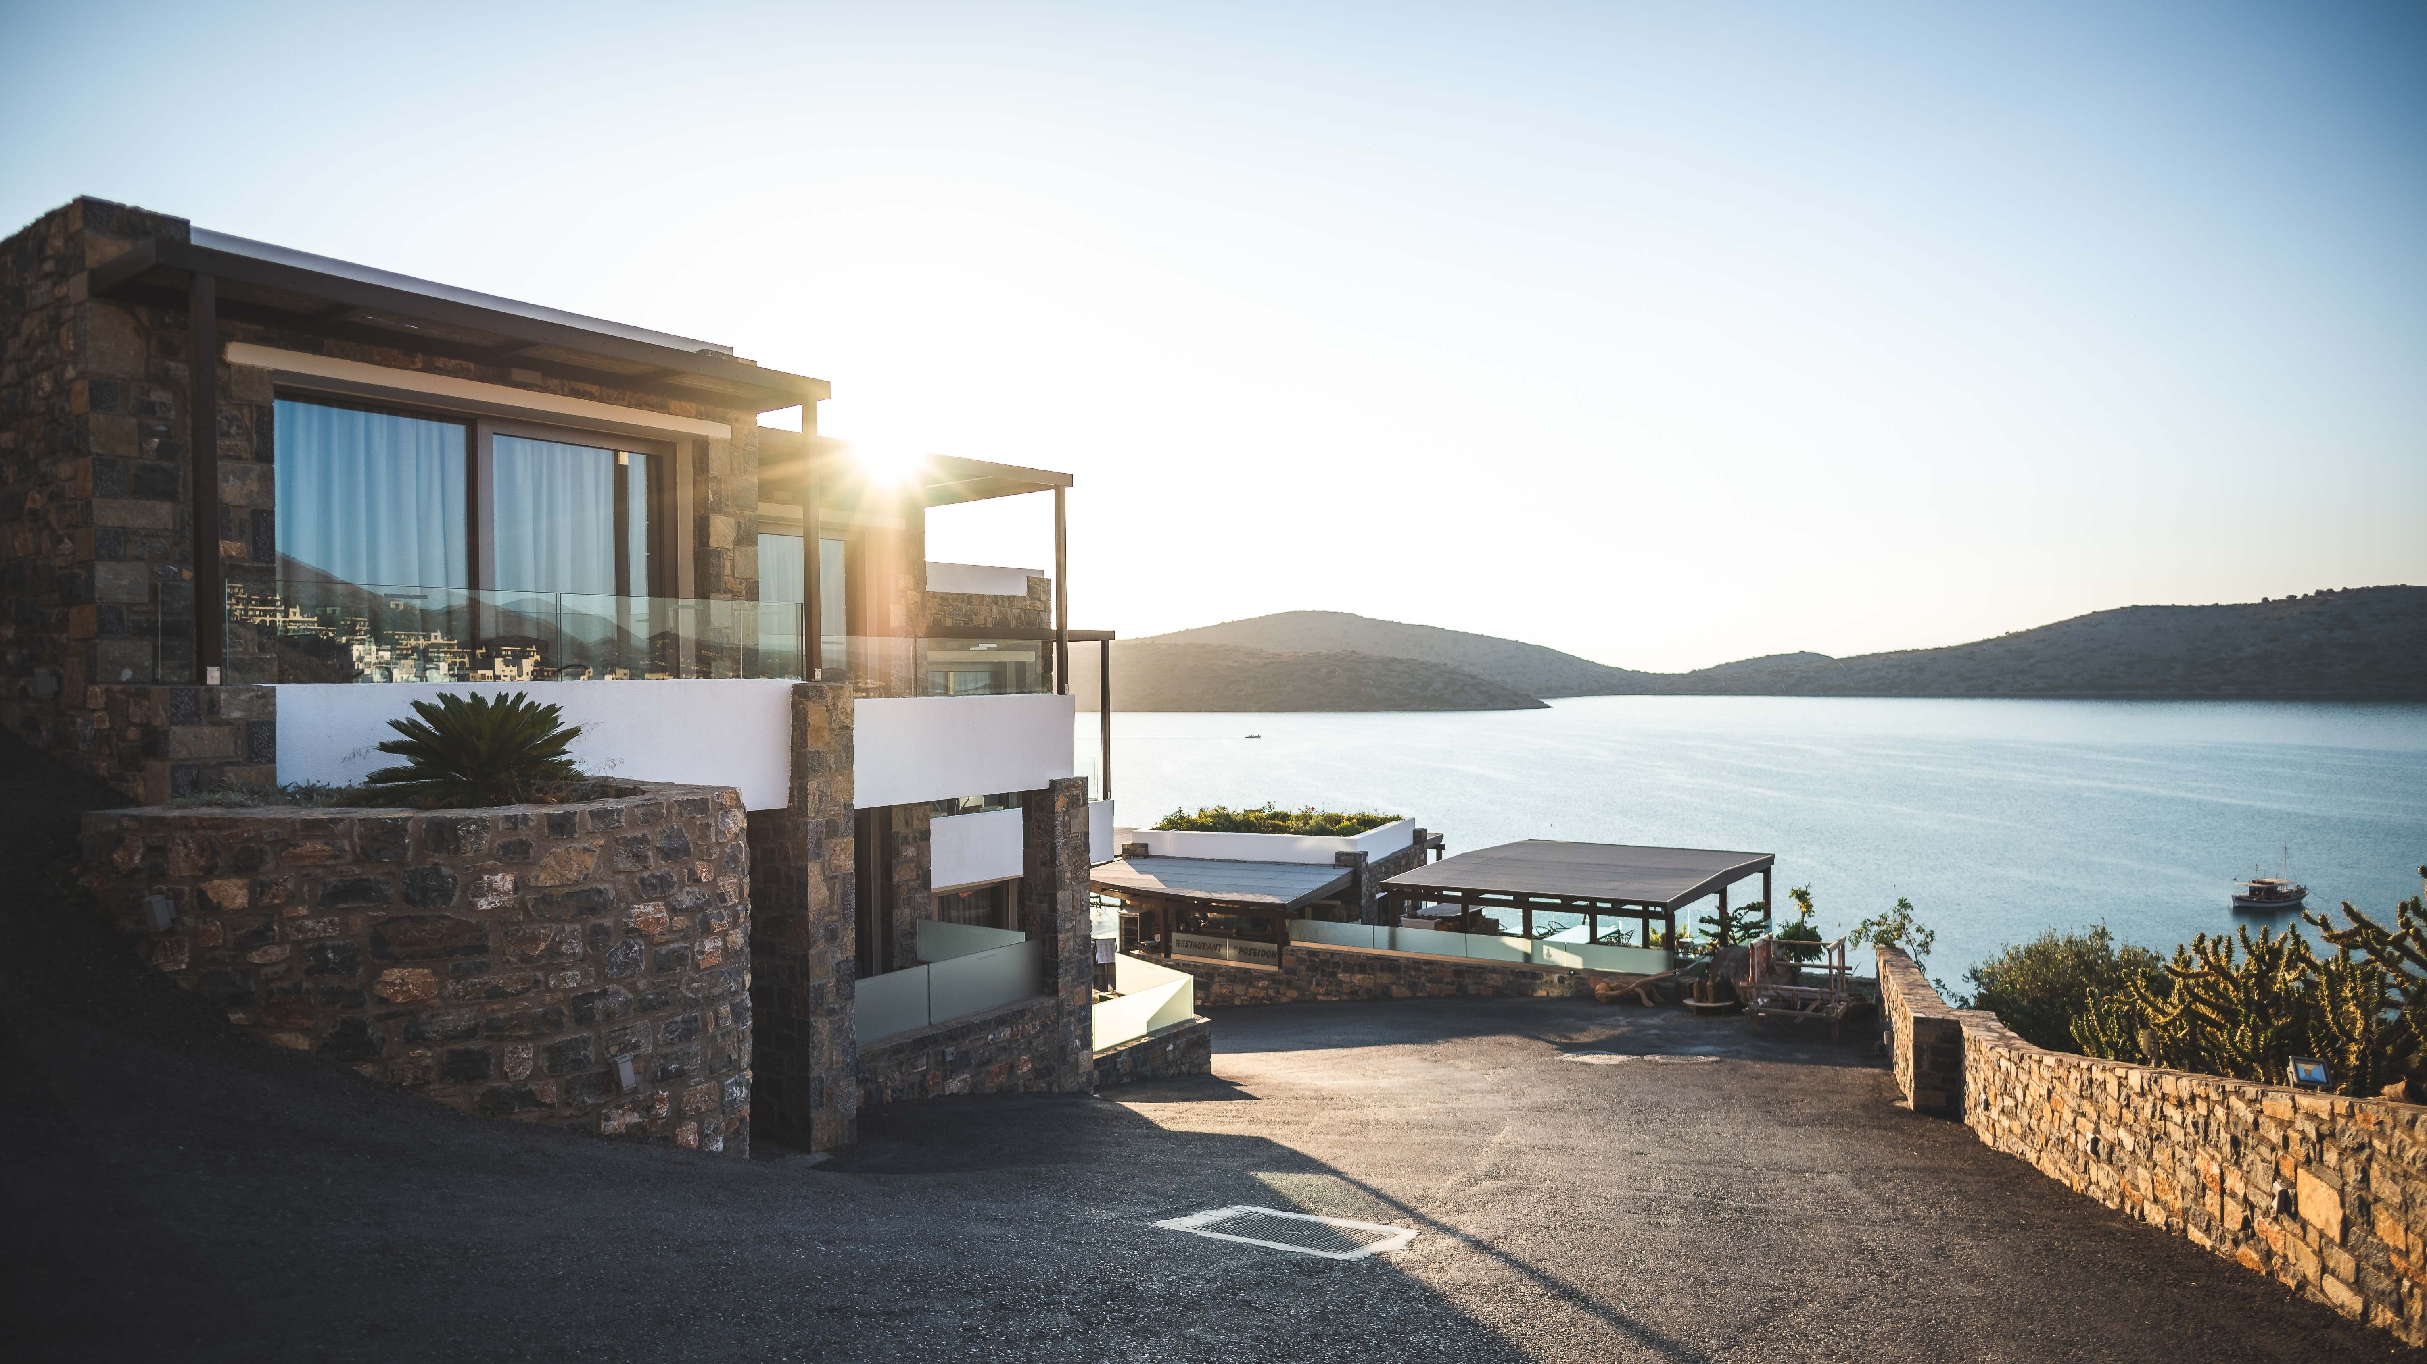
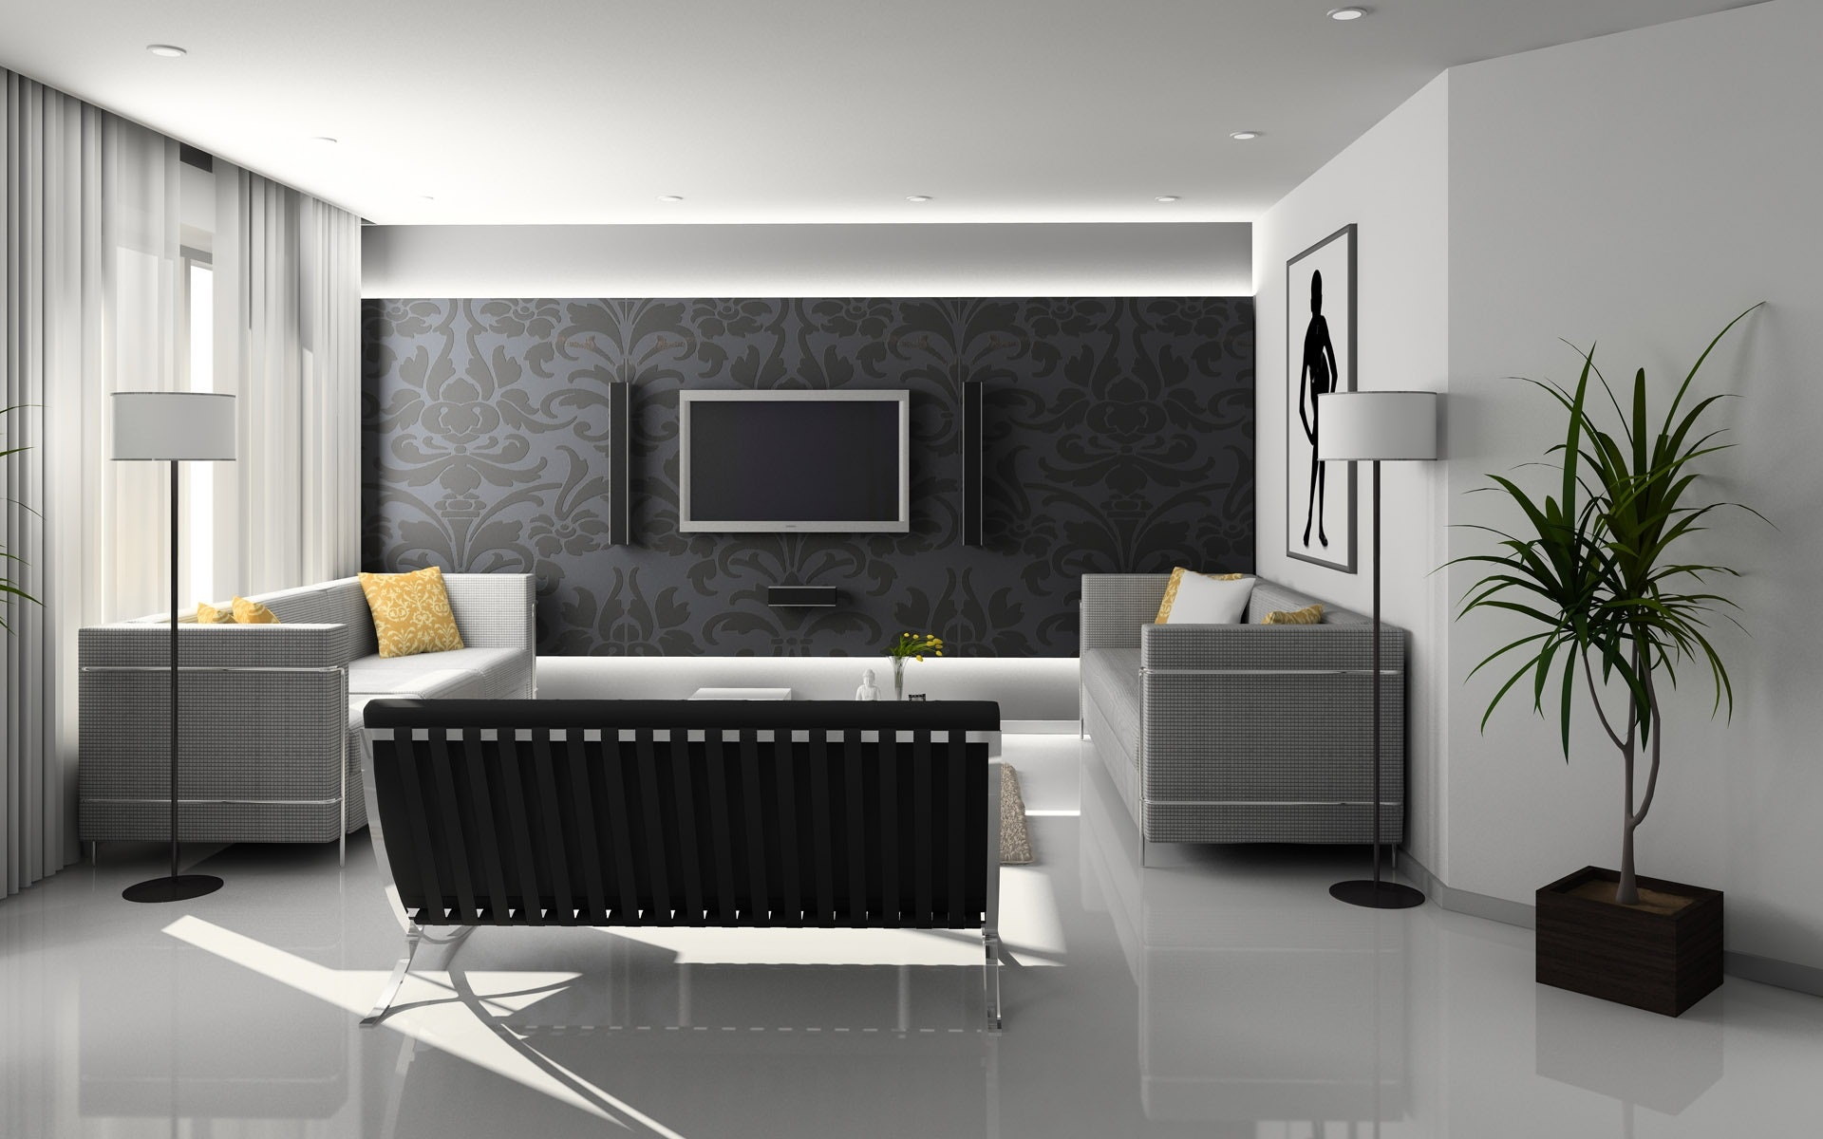
LOGO
LIVING ROOM VIEW – LAKE VIEW APARTMENTS
Add: Sea Face Plot No. 1, Juhu, Mumbai - 57
MAHARERA: XXXXXXXXXXX
Call Now for Bookings: 022 XXXXXXX

